Slide 1
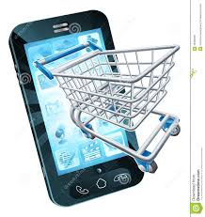

Smart Shopper - Application
Imran Ahamed
Ragupathy Krishnan Marimuthu
Surendar Rajavijayan Sundar
Vigneshwaran Kannan
Yuvanesh Vedaraju

Slide 2
Executive Summary
Application for groceries shopping
Customer needs vs Retailer suggestions
Implicit and Explicit purchase pattern
Help retail store to manage inventories

Slide 3
Goals & Objectives
To implement a system that helps user to find current and future needs
To provide scope for Business Intelligence to retailers
To shop with multiple retailers online

Slide 4
Project Justification
No more shopping tension
Improve inventory management for retailers
Future scope to integrate with online shopping system

Slide 5
Application features
Instant access to home groceries needs
Product and price data from purchase history
Product recommendations using automatic and manual purchasing patterns
Data storage with scope for analytics
API to integrate with online shopping system

Slide 6
Challenges
Universal login for mobile, tablet, laptop and desktop devices for all platforms
Product suggestions without historical data
Integrating the application with various websites for online shopping

